Slide 1


Managing Eating Disorders in children with Obesity: time For New intervention service models.
Shirley Adu RD (PhD Student Leeds Beckett University)

Slide 2
Aims
Introduction.
  My work experiences.
Eating disorders in children living with obesity.
  Definitions and prevalence.
  Causes and effects.
  Current treatment.
Recommendations for new intervention approaches.
Questions.

Slide 3
My career in child weight management
Tier 1
School Time Obesity Prevention (STOP) programme.
Tier 2
MEND – (Mind, exercise, nutrition, do it!).
Alive‘N’Kicking family weight management programme.
PhD- e-Health child/family weight management.
Tier 3
Preston Hospital –Tier 3 child weight management.
South London and Maudsley Hospital – Tier 3 Lambeth Healthy weight project.

Slide 4
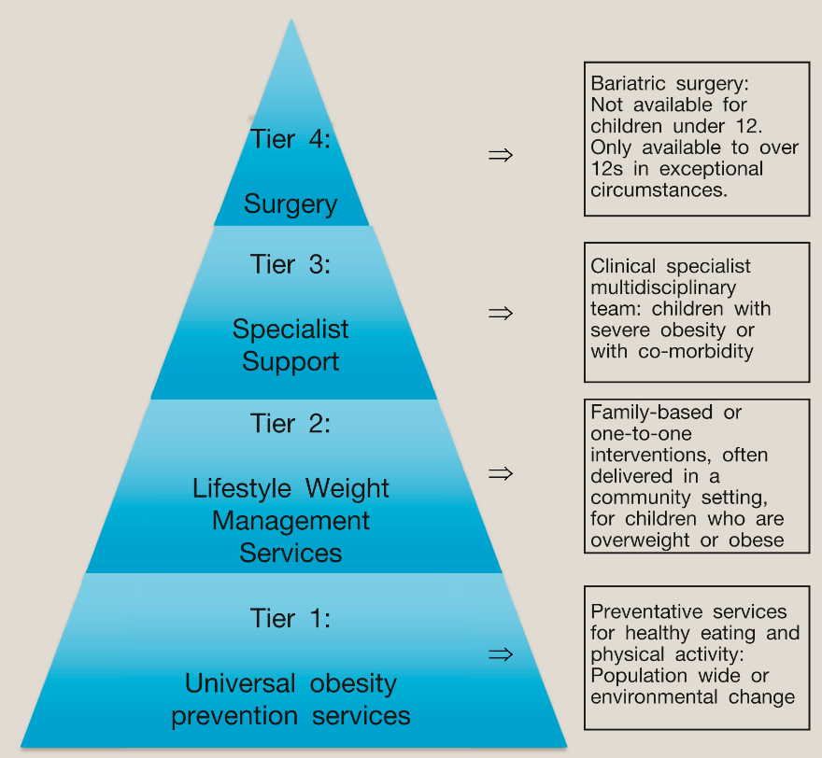
Tier 1-4 services
Tier 1-4 weight management specifications for children.
(Robertson et. al 2016)

Slide 5


Childhood obesity the story so far
Notes:
.

Slide 6


Childhood obesity the story so far

Slide 7

Why is childhood obesity a problem in the UK?
  A review of conventional F2F interventions:
  Low participant engagement (Mead et. al 2017).
  Limited intervention duration (Oude Luttikhuis et. al 2009).
  Poor long-term follow (Shrewsbury et. al 2018).
Notes:
As you all know childhood obesity is on the rise and one of the reasons for this rise is because the ci
Tier 1 weight management interventions are population level, public health interventions aimed at promoting healthy diet and activity behaviours to prevent the onset of excess weight. (). Tier 1 interventions focus on reinforcement of healthy eating and physical activity messages and includes public health and national campaigns as seen in the government funded Change4life campaign.
Tier 2 services are delivered by local community weight management services, that provide multicomponent community-based diet, nutrition, lifestyle and behaviour change advice, normally in a group setting environment. Normally people can only access these services for a limited time period often only 12 weeks.

Slide 8


Why the need for digital interventions?
  Why E-health?
  Evidence for efficacy limited and variable
  Overcoming challenges of conventional intervention
    Flexible appointment times
    Larger population reach
    Cheaper economical interventions
    Safer interventions
  Rise in the use of tech

Slide 9

What is Back2Basics?
The Back2Basics programme is an interactive, remote program that promotes affordable, healthy and practical lifestyle changes.
The program was created by dietitians in Australia from Newcastle University.
The program was created for children aged 4-11 years.
Notes:
1) The B2b programme is a fun and remote programme that teaches families of children between the ages of 4-11 years how to eat well and move more in an affordable and practical manner.
2) The programme was developed by dietitian in the Australia

Slide 10
B2B Australian Trial Results
Back2Basics pilot study Chi et. al (2019).
Improved dietary intake:
↓ percentage energy from energy dense nutrient poor food (-11%E; p¼.038) and ↑ percentage energy from nutrient-rich core food (þ11%E; p¼.045).
2) Weight maintenance
Children maintained their BMI and waist circumference at week 12.
3) Increased retention rates
B2B=78% at week 12, vs average rates of 27%- 73% (Newson, 2013).
Notes:
in the Back2Basics pilot study published by Chi et al (2019) children from families given SMS and two telehealth consultations delivered by a dietitian, in addition to 12 weeks access to a nutrition website and a private Facebook group improved their dietary intake. For example, the total daily energy intake was significantly reduced in the
Telehealth compared to Control group (-2835 kJ; p¼.026) as the Telehealth group had reduced percentage energy from EDNP (energy dense nutrient poor) food (-11%E; p¼.038) and increased percentage energy from nutrient-rich core food (þ11%E; p¼.045) compared to the controls, who demonstrated the reverse trend (i.e. increased total energy intake, increased percentage energy from EDNP food and decreased percentage energy from
core food). Likewise, children in the intervention groups had maintained their BMI, waist circumference at week 12. Furthermore, the pilot study by Chi et. al demonstrated an overall retention rate of 78% at week 12, a rate that is slightly higher than existing childhood obesity intervention studies, which reported retention rates ranging from 27% to 73% (Newson, 2013).

Slide 11


B2BUK PhD trial aims
Adapt B2B for 4-11 year olds in North Yorkshire.
Test the feasibility and acceptability of B2B using pre and post intervention study.
Randomise Control Trial and roll out.
Notes:
Adapt B2B e-Health child weight management programme for families with children between the ages of 4-11 years in North Yorkshire.

Slide 12
B2B trial evaluations
Tier 2 components not addressing eating disorders and disordered eating behaviours in childhood obesity.
8 children presented with Eating disorders and disordered eating behaviors.
  6 children= Binge eating/Compulsive eating
  2 child= Avoidant and Restrictive Eating Disorders (ARFID).
Participants feedback
  ‘I could have looked up diet tips on Google myself, I just need to know why I can stop eating’-JJ (12yrs).
  ‘Provide CBT to help with compulsive eating’-JJ’s mum.

Slide 13
ED and Childhood obesity
ED is ‘A mental health condition where one uses food and eating to cope with emotions or situations’ (NHS, 2022).
Binge Eating Disorders(BED)
‘The consumption of an objectively large amount of food (larger than what most people would consume under similar circumstances) coupled with a sense of loss of control over the eating’ (Stabouli et al. 2021).
Avoidant restrictive food intake disorder (ARFID)
Avoiding types of food, having restricted intake in terms of overall amount eaten, or both (Stabouli et al. 2021).

Slide 14
Risk factors for ED in children with obesity
Participation in weight management programmes (Jabeile et al. 2019).
Environmental risk factors (Libbey et al. 2008).
  Family and peer teasing, perceived social pressure, frequent criticism or bullying.
  Adverse child experiences.
Individual risk factors (Cameron et al. 2019; Nicoletti et al. 2019).
  Genetic predisposition.
  Neuropsychological and brain activity risk factors.
Biochemical risk factors (Hainer et al. 2006).
Gut microbiome imbalance (Biedermann et al. 2015)

Slide 15
Prevelance of Eating Disorders in Obesity:
The exact prevalence of ED in children living with obesity is unknown.
Most figures are estimated in part due to differences in measurement/assessment tools used for diagnosis, in particular self-report surveys vs. diagnostic interviews.
Research in this area is also limited.
Notes:
The diagnosis of binge episodes in children and adolescents can be challenging for a number of reasons. First, the definition of an objectively large amount of food during development can be difficult and uncertain ^{5,6}. Indeed, a child’s caloric intake may vary due to growth spurts and changes in activity ⁷. Furthermore, report of food intake, as well as the ability to articulate loss of control can be challenging in children and adolescents. For this reason, clinician-expert interviews are necessary rather than reliance on self-report in order to better characterize an eating episode as a binge ⁸. Even with interviews, we still rely on self-reported food intake, which is poorly related to actual objectively measured intake ⁹. Verbal descriptions of portion and/or pictures of portions of food may aid in the assessment ¹⁰.
Second, the criterion of loss of control may be difficult for children and adolescents to understand. Tanofsky-Kraff and colleagues ⁶ have used terms like “numbing” or “zoning out” to help children conceptualize loss of control (LOC). Although challenging to assess, the inclusion of LOC in the measurement of binge eating is vital, as it is associated with more psychosocial impairment than overeating alone ⁵. Marcus and Kalarchian ¹¹ proposed alternative BED criteria for children that highlights the LOC feature and eliminates the objectively large amount of food.
Their criteria include:
recurrent episodes of binge eating, defined by both of the following
food seeking in the absence of hunger (e.g., after a full meal)
a sense of lack of control over eating (e.g., endorse that “When I start to eat, I just can’t stop”)
binge episodes are associated with one or more of the following
food seeking in response to negative affect (e.g., sadness, boredom, restlessness)
food seeking as a reward
sneaking or hiding food
symptoms persist over a period of 3 months
eating is not associated with the regular use of inappropriate compensatory behaviors (e.g., purging, fasting, excessive exercise) and does not occur exclusively during the course of anorexia nervosa or bulimia nervosa
These criteria were not officially adopted into the DSM-5, nor have they received much direct investigation through research. However, they are included here to highlight the uncertainty in the field about whether the current criteria can be applied to children and adolescents without adaptation.
Children and adolescents with obesity are vulnerable to the development of eating disorders because obesity and eating disorders have several shared risk factors. Disordered eating attitudes and behaviours, as precursors to eating disorders, are also elevated in children and adolescents with obesity.155 Although obesity treatment helps improve eating disorder symptoms, including binge eating and loss of control in most youth with obesity,143,144 a small number undergoing obesity treatment might develop an eating disorder during or after an intervention.143 Although whether this low risk of developing eating disorders differs in youth who do not present for clinical treatment remains unclear, it is an important consideration for clinicians providing obesity care. For over a decade, it has been recommended that there be screening of disordered eating attitudes and behaviours before obesity treatment,76,154 particularly with the use of dietary interventions,112 to identify undiagnosed eating disorders. However, guidance on how this should occur in practice is scarce. Screening tools that assess for binge eating disorder specifically in children156 and adolescents157 with obesity are available but a self-report screening tool to assess for the broad spectrum of eating disorders for those with obesity and with adequate diagnostic accuracy is lacking. Eating disorder symptoms should not prevent the provision of obesity care;158 rather,

Slide 16
Treatment recommendations for ED
Weight management intervention in addition to:
BED Treatment (NICE)
Guided self-help (4 and 9 sessions that last about 20 minutes each).
Cognitive behavioural therapy (CBT).
ARFID Treatment (NICE)
Desensitisation and exposure therapy.
Dialectical behaviour therapy.
CBT.
These interventions not widely available in Tier 1-4 services.
Notes:
Guided self-help
Children, young people and adults who have binge-eating disorder should be offered guided self-help. This means working through a book about binge eating, and having short sessions with a practitioner (such as a therapist) to check how you are doing. People generally have between 4 and 9 sessions that last about 20 minutes each. However, you and your practitioner should agree how many sessions to have and how long they will last, depending on what works for you.
Guided self-help may not be right for everyone, and if you don't feel it has helped after 4 weeks, you may be offered group sessions of cognitive behavioural therapy (CBT). This should take place in 16 weekly sessions over 4 months, each one lasting about 90 minutes. It should cover:
showing you how to plan your food intake every day
working out the triggers that make you binge
helping you to change negative beliefs about your body
helping you stick to your new eating habits (this is called relapse prevention).
You may be offered individual CBT rather than group CBT. The treatments are similar but individual CBT involves having one-to-one sessions with your practitioner rather than group sessions.

Slide 17
Impact of ED
Physical
  Delayed development.
  Metabolic disorders.
  Cardiovascular problems.
Mental
  Depression and anxiety.
Ineffective WMS
  Disappointment.
  Increased prevalence of obesity.

Slide 18
The need for new interventions
Eating disorders in people with higher weight have been consistently under-recognised and under-treated due to:
  Outdated policies and lack of research,
  Patients being misdiagnosed and dismissed by health professionals or excluded from eating disorder treatment services due to weight stigma,
  Current components of Tier 1-4 weight management services are not addressing ED in childhood living with obesity.

Slide 19
The need for new interventions
Every individual with an eating disorder deserves equitable, safe, accessible, and evidence-based care regardless of their body size.
Safe guard future generations.
Tackle obesity and reduce health costs.

Slide 20
Recommendations for change
More research into this topic area.
  What works vs what does not work.
Policy changes.
  for diagnosing and treating ED in people with higher BMI.
Development and provision of scalable interventions.
  First Steps ED.

Slide 21
Conclusions
High prevalence of ED in children living with obesity.
ED experienced by people with higher weight has been consistently under-recognised and under-treated.
Lack of effective evidenced-based treatment is unethical.
There is an urgent need for best practice approaches to the management of eating disorders in people with higher weight and evidence-based clinical practice recommendations.

Slide 22
Thanks for listening

Slide 23


Slide 24
Bibliography
Azar KMJ, Bennett GG, Nolting LA, Rosas LG, Burke LE, Ma J (2018). A framework for examining the function of digital health technologies for weight management. Journal of Translation Behaviour 1;8(2):280-294. doi: 10.1093/tbm/ibx050.
Biedermann, L. and Rogler, G., (2015). The intestinal microbiota: its role in health and disease. European journal of pediatrics, 174(2), pp.151-167.
Cameron, J.D., Tasca, G.A., Little, J., Chyurlia, L., Ritchie, K., Yeh, E., Doucette, S., Obregon, A.M., Bulman, D.E., Doucet, É. and Goldfield, G.S., (2019). Effects of fat mass and obesity-associated (FTO) gene polymorphisms on binge eating in women with binge-eating disorder: The moderating influence of attachment style. Nutrition, 61, pp.208-212.
Chai LK, Collins CE, May C, Ashman A, Holder C, Brown LJ, Burrows TL (2019). Feasibility and efficacy of a web-based family telehealth nutrition intervention to improve child weight status and dietary intake: A pilot randomised controlled trial. Journal of Telemedicine and Telecare. doi: 10.1177/1357633X19865855.
Hainer, V., Kabrnova, K., Aldhoon, B., Kunesova, M. and Wagenknecht, M., (2006). Serotonin and norepinephrine reuptake inhibition and eating behavior. Annals of the New York Academy of Sciences, 1083(1), pp.252-269.
Jebeile, H., Gow, M.L., Baur, L.A., Garnett, S.P., Paxton, S.J. and Lister, N.B., 2019. Treatment of obesity, with a dietary component, and eating disorder risk in children and adolescents: A systematic review with meta‐analysis. Obesity Reviews, 20(9), pp.1287-1298.

Slide 25
Bibliography
Libbey, H.P., Story, M.T., Neumark‐Sztainer, D.R. and Boutelle, K.N., 2008. Teasing, disordered eating behaviors, and psychological morbidities among overweight adolescents. Journal of obesity, 16(S2), pp.S24-S29.
Nicoletti, C.F., Delfino, H.B.P., Ferreira, F.C., Pinhel, M.A.D.S. and Nonino, C.B., 2019. Role of eating disorders-related polymorphisms in obesity pathophysiology. Reviews in Endocrine and Metabolic Disorders, 20(1), pp.115-125.
National Institute for health and Excellence (NICE CG NG69) Eating disorders: recognition and treatmentAvailable online at https://www.nice.org.uk/guidance/ng69/ifp/chapter/Other-eating-disorders [Accessed on 20th 01 2023]/
Reilly JJ, Kelly J.(2011). Long-term impact of overweight and obesity in childhood and adolescence on morbidity and premature mortality in adulthood: systematic review. International Journal of Obesity. 2011 Jul;35(7):891-8. doi: 10.1038/ijo.2010.222.
Stabouli, Stella, Serap Erdine, Lagle Suurorg, Augustina Jankauskienė, and Empar Lurbe. (2021). "Obesity and Eating Disorders in Children and Adolescents: The Bidirectional Link“. Journal of nutrients. 13, no. 12: 4321. https://doi.org/10.3390/nu13124321.
Wendy Robertson, Marie Murphy, Rebecca Johnson (2016). Evidence base for the prevention and management of child obesity. Journal of Paediatrics and Child Health. Volume 26, Issue 5.

