Slide 1
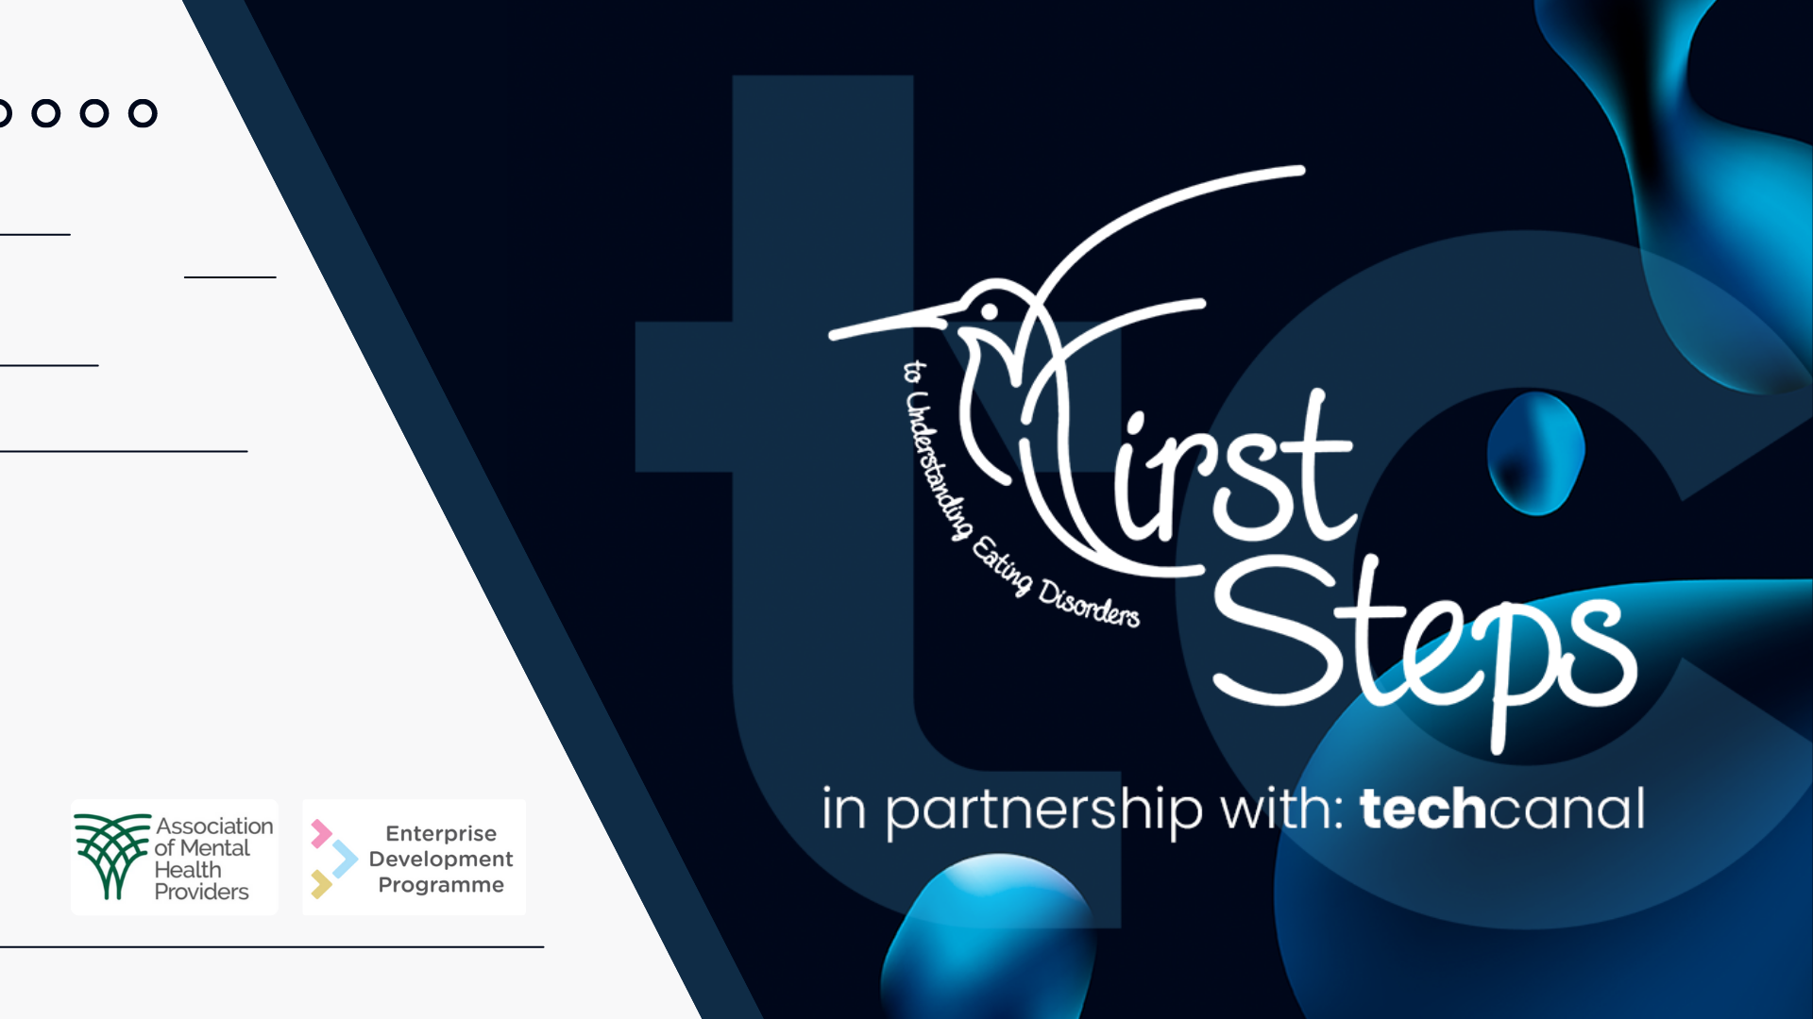
Notes:
World Obesity Day returns on 4 March 2023 with the theme: ‘Changing Perspectives: Let’s Talk About Obesity’.
The campaign will use conversation and stories to help people correct misconceptions surrounding obesity, acknowledge its complexities, and take effective, collective action. Because when we all talk, debate and share, we can shift norms and transform health outcomes for everybody.
World Obesity Day 2023 is an opportunity to kick-start important discussions about obesity in your area and encourage positive action among your target audiences.
Together we can change the narrative around obesity.

Slide 2
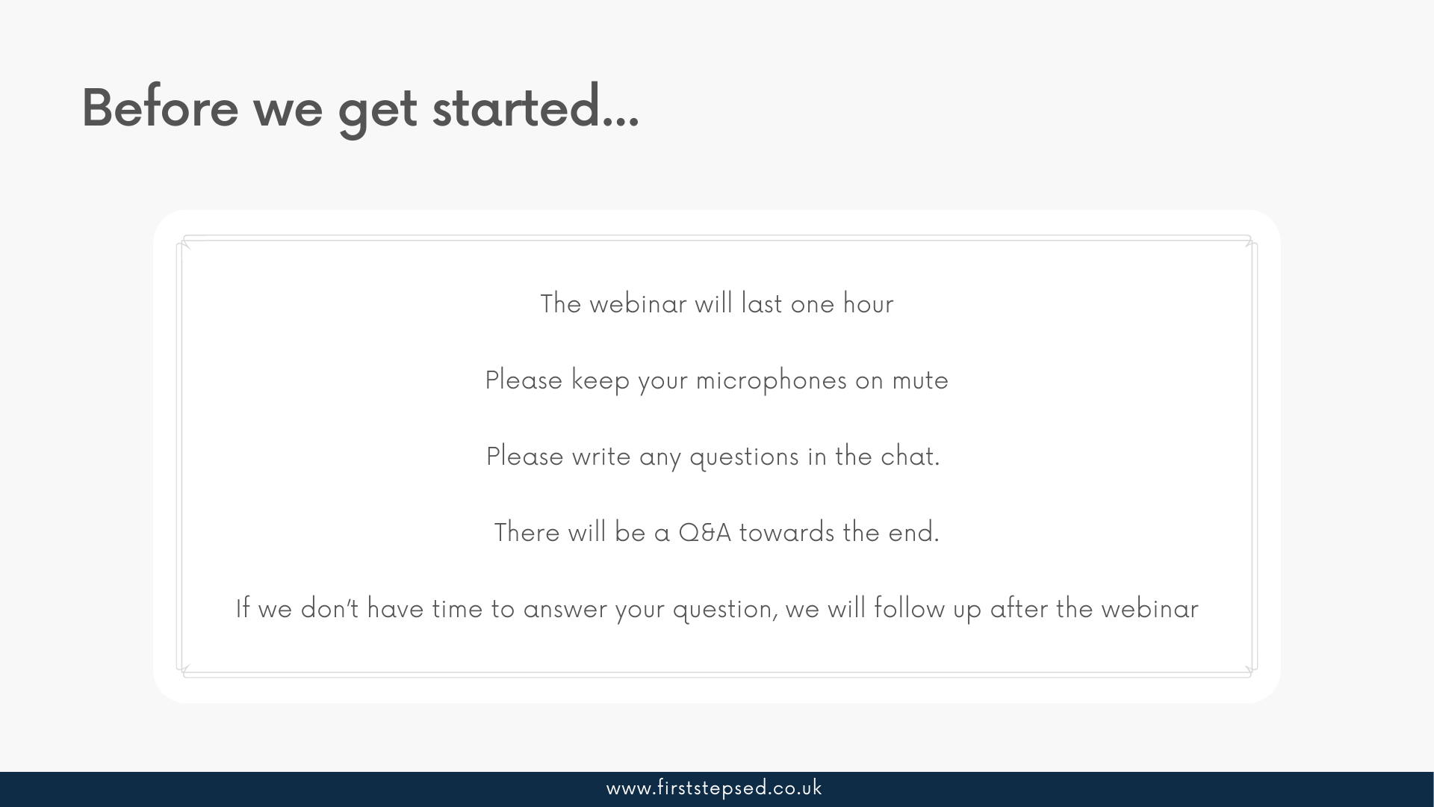

Slide 3
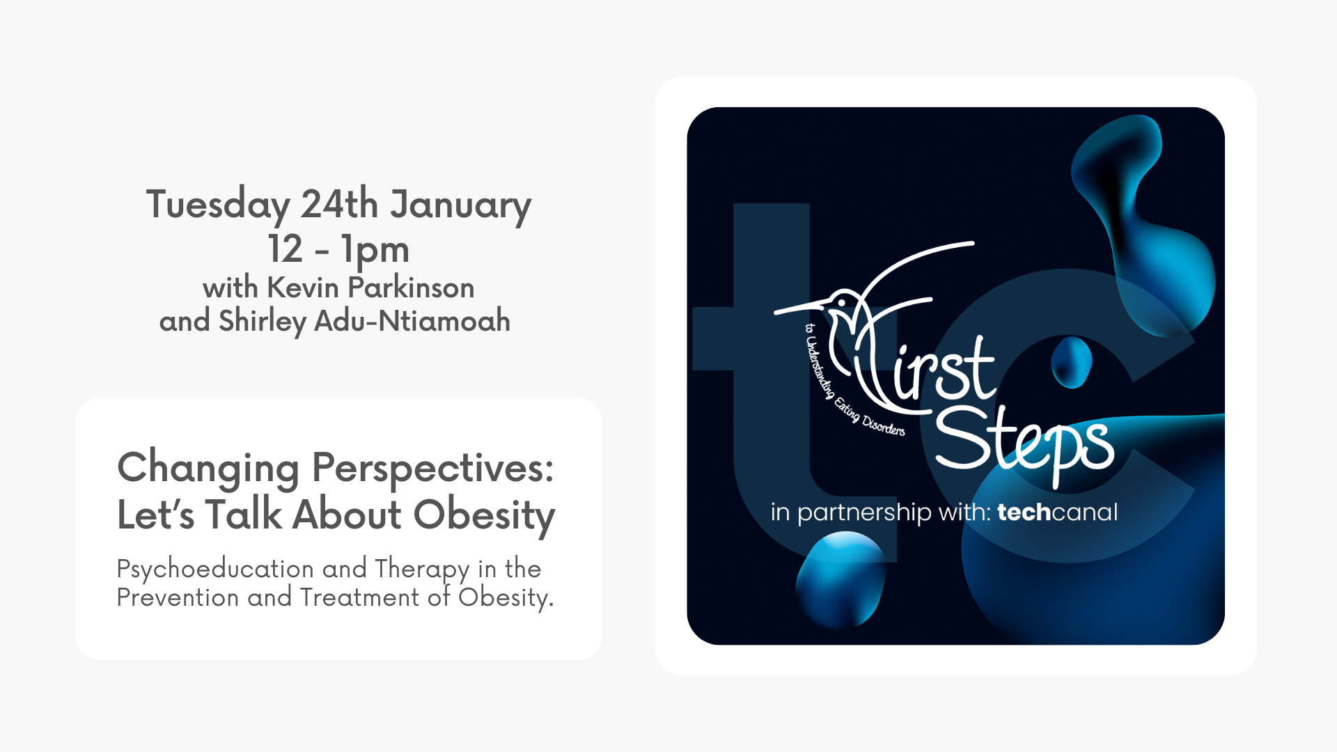
Notes:
Kevin and his team (First Steps ED) take a person centred approach and provide hope, opportunities and choices so that recovery is possible and individuals can thrive.
A more connected and collaborative approach to knowledge sharing of successful interventions can help aid our understanding in tackling complex issues.

Slide 4
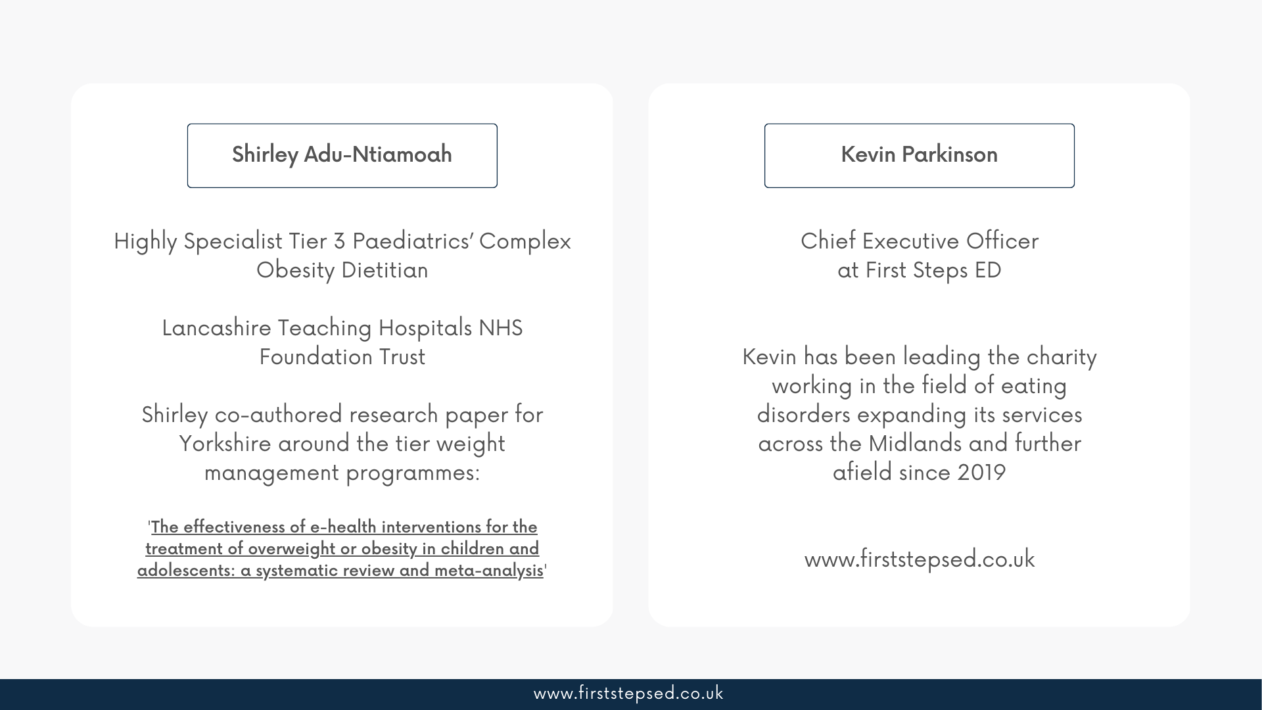

Slide 5
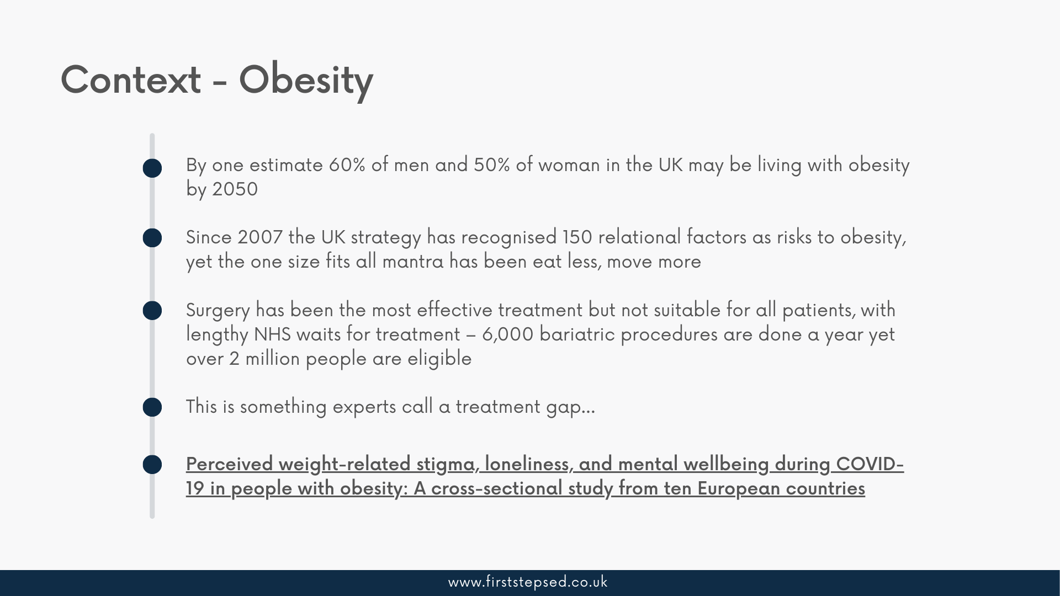
Notes:
People living with obesity can be associated with low mental wellbeing, poor quality of life, depressive symptoms, and dissatisfaction with body image and often co-occurring disordered eating behaviours. In this review, the authors concluded that the stigmatising negative portrayals of obesity in wide ranging medias can be linked to psychological harm for both viewers and those with obesity.
Eating disorders psychopathology has been supporting people in larger bodies and living with obesity prior to Covid19 but like all disordered presentations, the demand for our services continues to increase.

Slide 6
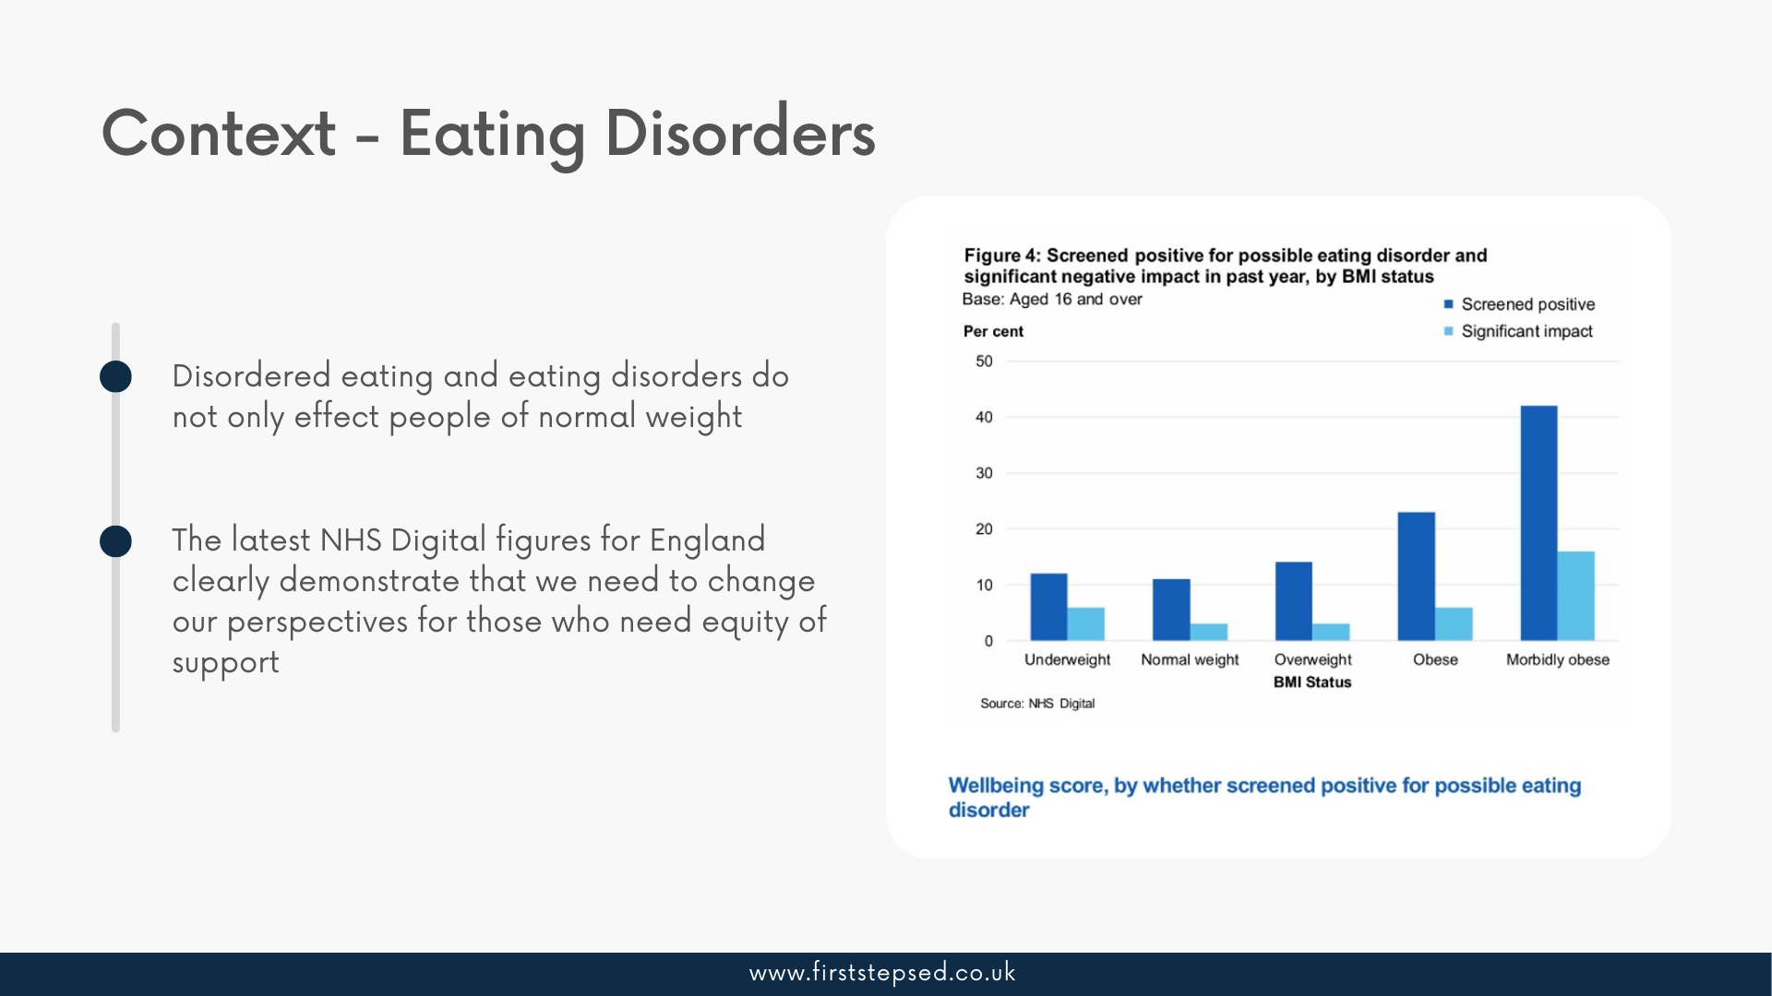
Context – Eating Disorders
Notes:
In the darkest moments of her eating disorder, Katie received nothing but praise and congratulations.
She was shedding wight rapidly and talking in vivid detail about the dangerous tactics she was using to drop the kilo’s, but no one raised an alarm.
‘’I was encouraged and people knew exactly what I was doing’’. When she told her story about my eating disorder, professionals in our field would say ‘’those are textbook signs’’.
So why did no one realise Kate was sick? Why did no one encourage her to get help?
‘’Because I’m fat’’, Kate says. The 28 year old has spent most of her life in ‘a larger body’, and knows all too well how the stigma around fatness, health and beauty affects plus size. Especially girls and woman.

Slide 7
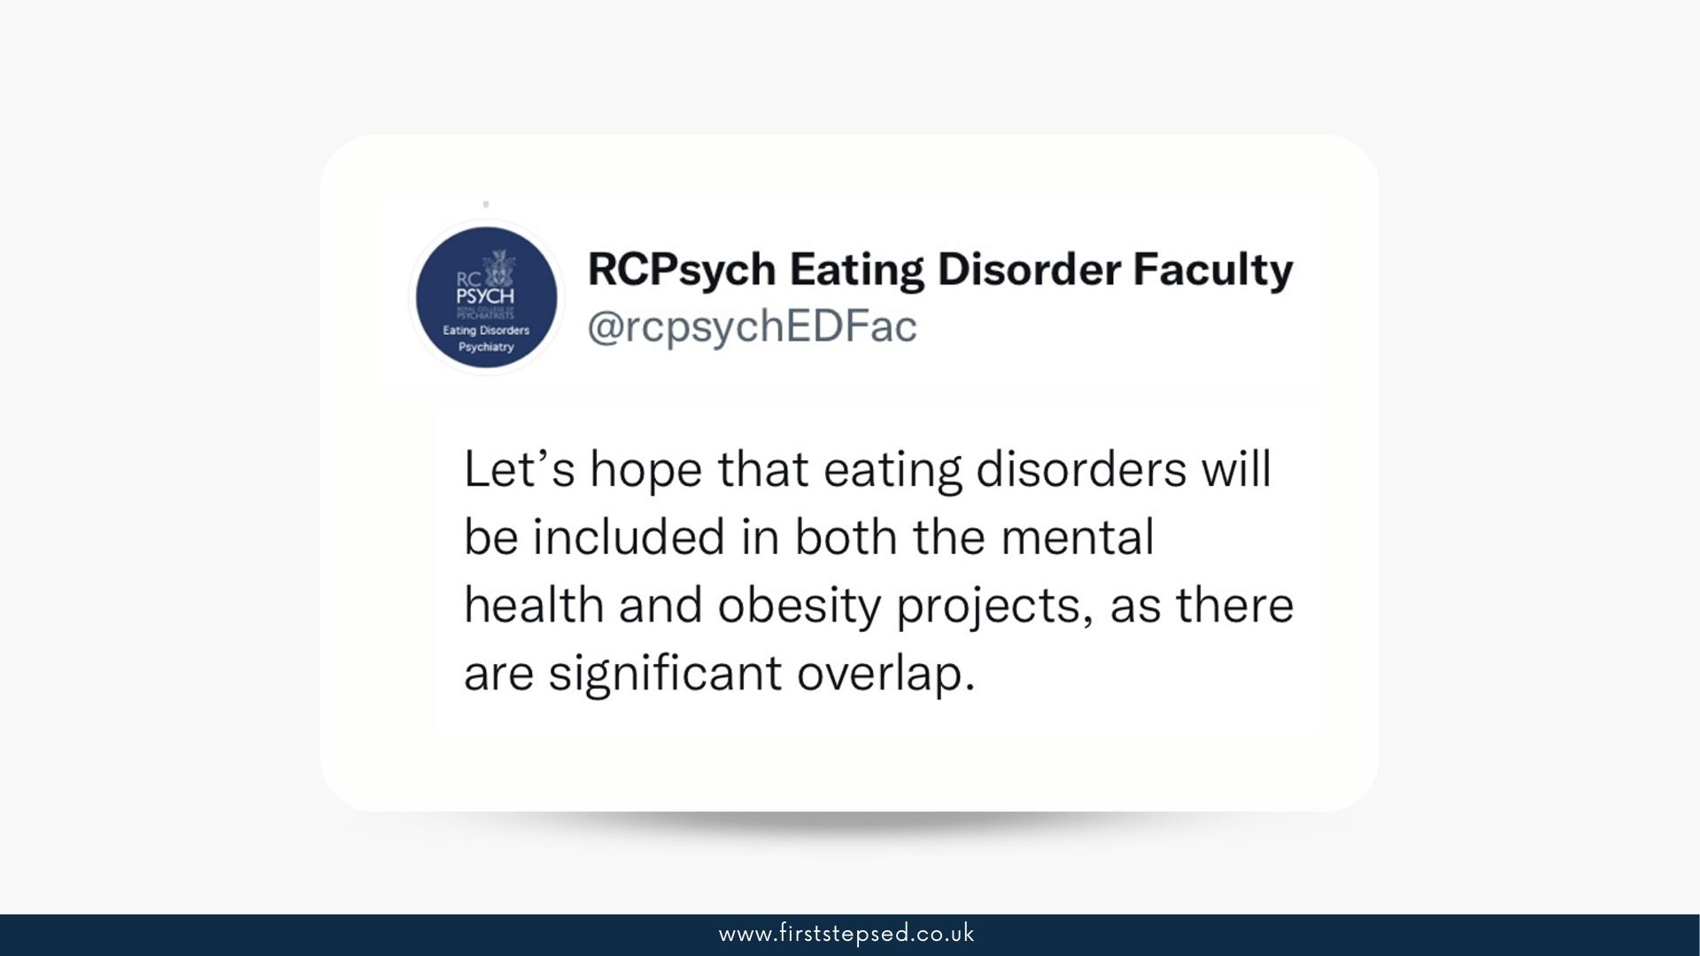
Notes:
In fact, many fat people who have engaged in disordered eating behaviours say they were praised for it and that can be a huge motivator to continue.
Most of us have nothing but people telling us everything that is wrong with our body and how we live our lives, and that we need to eat less and exercise more.
Comments like this have an impact on body image in our formative years, with many incredible vulnerable when they start university or work.
Given we don’t want people to get eating disorders, it is easy to find weight loss advice everywhere we turn, social media, family, friends and healthcare professionals. There is no shame around counting calories, no shame around overexercising, those things are normalised in our society.
The only difference is what your body looks like, this is what most people determine whether or not those behaviours are healthy or not. Had Kate been in a smaller body or seriously underweight, will most people have picked up on her eating disorder sooner and would she have been able to get help.
YOU CANT TELL IF SOMEONE HAS AN EATING DISORDER BY LOOKING AT THEM – Sadly, Kate’s story isn’t unique.

Slide 8

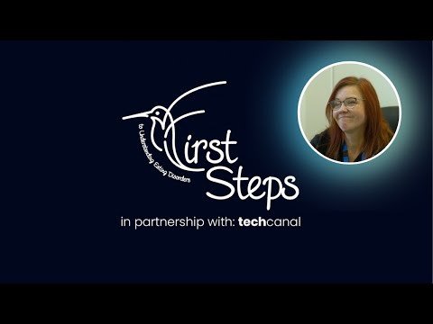
HOLDING PAGE FOR VIDEO
Notes:
Shirley talks through her lived experience in obesity and disordered eating, as well as the journey through recovery where today Shirley is employed by First Steps ED as a Peer Support Worker working with our NHS clinical colleagues in Specialist Adult Eating Disorders
https://youtu.be/cB7OmX0u2Ho

Slide 9
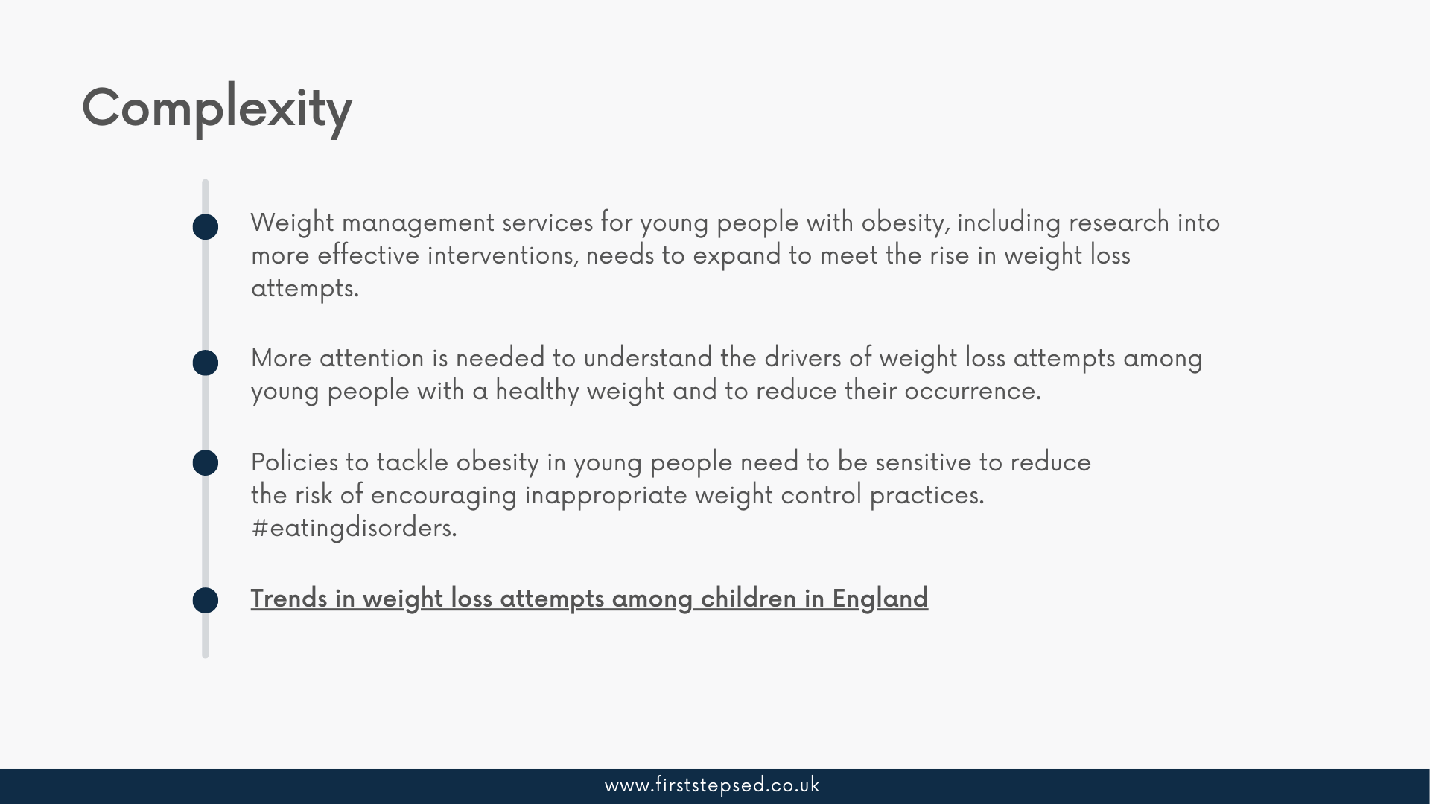
Complexity
Notes:
Our health and wellbeing is an important element of everyday life, especially in relation to our body image and perception. We are impacted by a number of unique factors including our age, genetics, socio-economics, mental health, ability or disability, as well as our relationship with food.
In collaboration, our objective is to develop strategic partnerships with NHS and independent sector obesity services to provide psychotherapeutic approaches to patients and clients accessing weight management services.
Our partnered services will measure the impact of our intervention through a reduction in follow-up attendance following surgical adjustments, increased capacity within pathways which will allow for clinical services to meet increases in demand and patient satisfaction.
This is what we have been doing for almost 2 decades across the field of eating disorders and in recent years in the field of obesity.

Slide 10
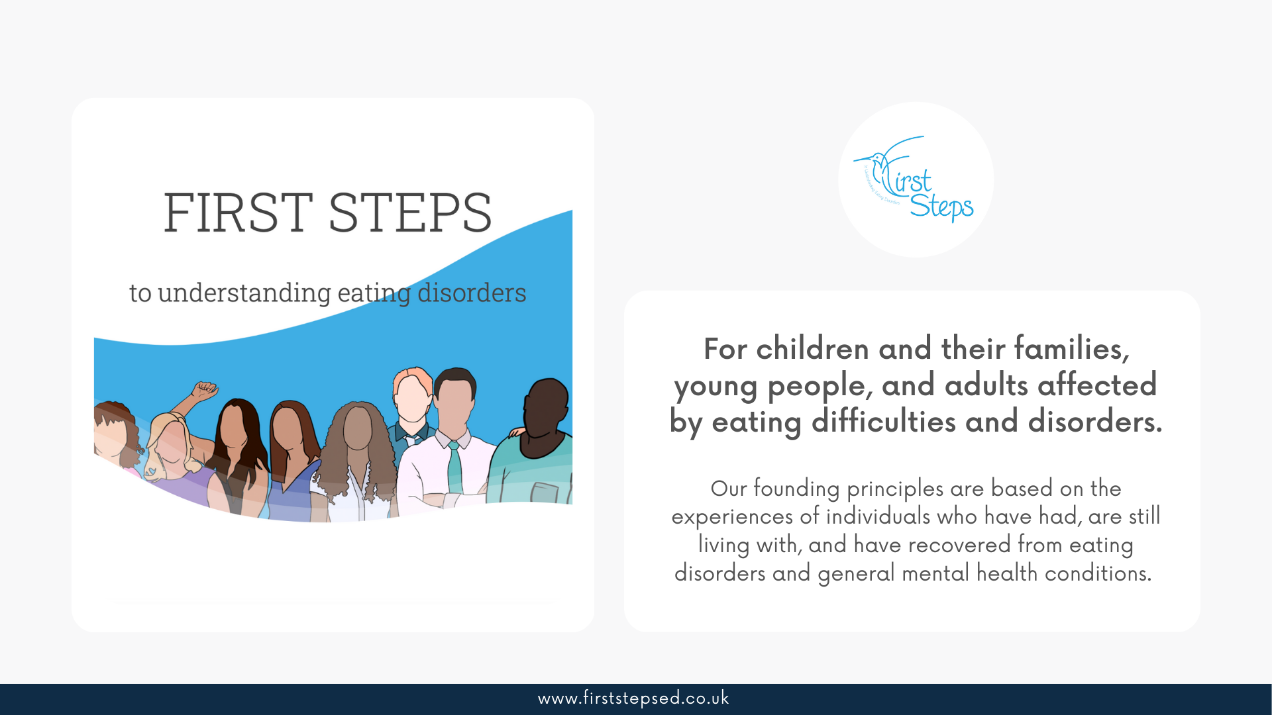
Notes:
First Steps ED is a leading eating disorder charity working across the Midlands and further afield working as an integrated NHS/VCSE partner with integrated pathways with CAMHS ED and Adult ED teams and since 2019 with Dietetics teams where our staff work across the full spectrum of community tier 1 and 2, specialist tier 3 outpatient and tier 4 inpatient services where we are commissioned.
We are an All Ages, genders and backgrounds service supporting children and their parents/cares from 5 years plus with individual and group therapy services and work with an extensive network of universities, PhD students and researchers in the field of eating disorders and obesity codesigning research informed psychoeducation guided self-help workshops and accredited professional training which with our coproduction partners are endorsed by healthcare and Royal Colleges.
The charity accepts self, parent/carer and professional referrals and we have no access criteria, do not ask or use BMI and focus on breaking down stigma’s because disordered eating and disorders do not discriminate staying true to our communities

Slide 11
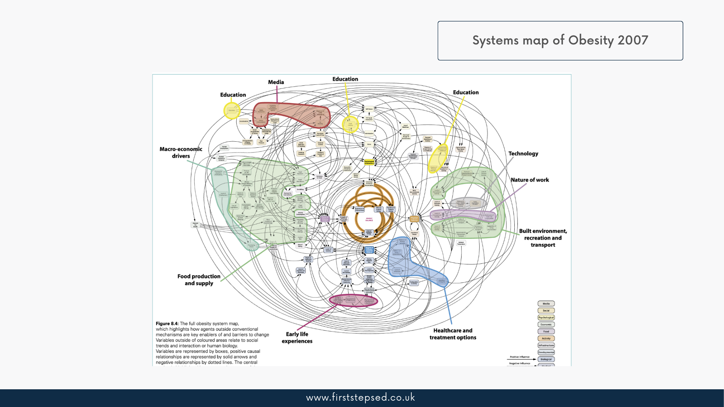
Notes:
Developed by Public Health in 2007 who identified all the causes of obesity and all the relationships between all of those causes.
108 different causes of obesity and the relationships with all 108 causes. The cause of obesity is all of these causes and relationships working together, why we have since 2007 only had a one size all fit approach and spending £6bn a year may now need a different system approach.
In this webinar we are going to briefly touch on what you see at the bottom right hand corner of the system map – healthcare and outcomes!

Slide 12
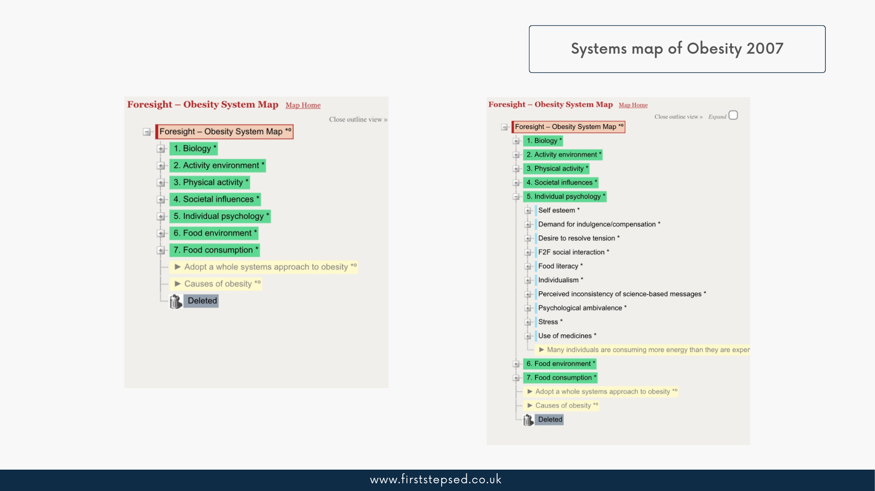
Obesity System Map
Notes:
Helpfully, the Government Foresight department also mapped the 108 causes and their relationships which we can see on the left hand side and we will focus the short time we have with you on Individual Psychology and how as an eating disorder charity we developed our support services on 3 themes;
https://debategraph.org/Stream.aspx?nid=365986&vt=outline&dc=all

Slide 13
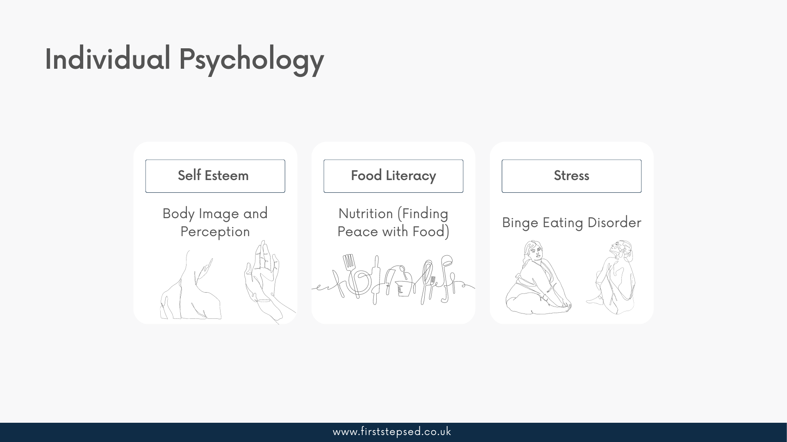
Individual Psychology
Notes:
Our relationship with food can change over time, especially when we are young and still navigating nutrition and body image.
A young person’s relationship with food might begin to deteriorate if they begin to use foods as a coping strategy for low mood, anxiety or other times when they are bored, angry, lonely or sad. Using food to help cope with painful situations is a problem, and can often happen without the individual realising it.
Body image issues and low self-esteem can be an underlying issue, alongside the fear of getting ‘fat’. The young person might feel as though disordered eating behaviours are a solution for their feelings, which can make identification and recovery difficult.
Our appetites do change over time, and even from a young age this can be normal. Teenagers may try out a ‘fad’ diet or switch up their usual eating habits for a period of time. This is not necessarily a cause for concern but if you feel as though it is affecting their day-to-day life or routine, check in with them and see how they are doing.

Slide 14
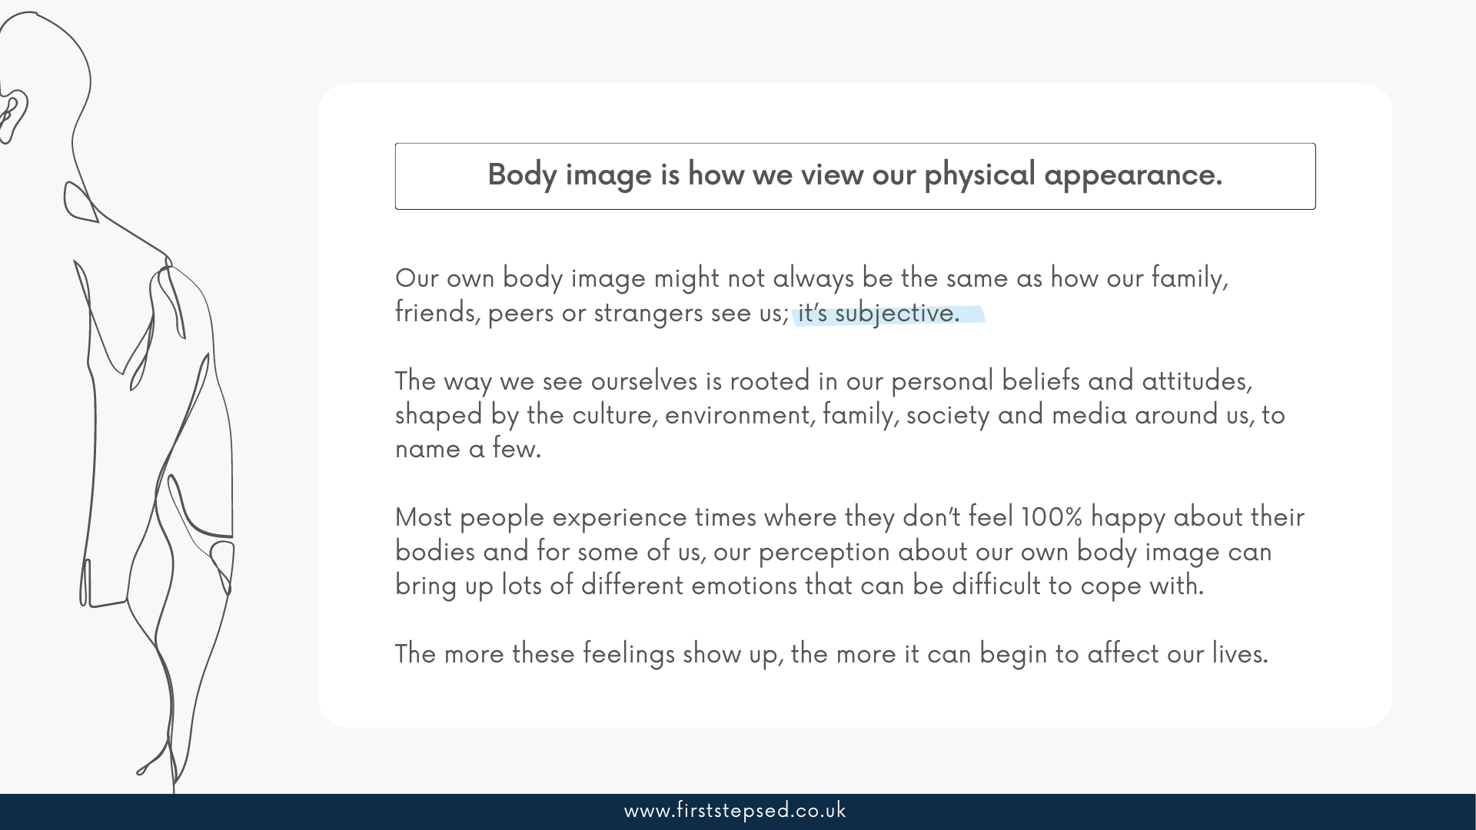
Notes:
Read more at: https://firststepsed.co.uk/resources/body-image-and-perception/
Negative feelings around body image can be a problem too, and can teach a child that our appearance is linked to our self-worth. In fact, research has found that the way a child feels about their body begins to develop as early as three years old (source: McCabe et al. 2016) so it is really important to be mindful of the way we discuss our bodies in front of young people.
Children and young people take in more than we think, young brains are like little sponges, absorbing lots of information all the time. Body expectations from parents and caregivers can be strongly internalised (meaning we absorb the ideas as being normal, often without even knowing it). This focus can lead to children feeling like they have to “fit in” and if they don’t, they may feel guilt and/or shame around their body or appearance.
Regardless of actual appearance or weight, children are more likely to develop body image problems (a common risk factor of eating disorders) when they are in an environment where friends and family have eating or body issues. In fact, one study showed that 81% of 10-year-olds are afraid of being fat (Mellin et al., 1991).
In our field, we now recognise that more children and young people of healthy weight are growing up experiencing disordered eating behaviours including restricting, purging and over exercising. In specialist clinical settings our NHS peers are seeing eating disorder presentations at later stages of complex and severe with more people of all ages requiring medical stabilisation for their eating disorder.
Body image and perception is so important to approach for young people during their formative years and people of all ages who are vulnerable.

Slide 15
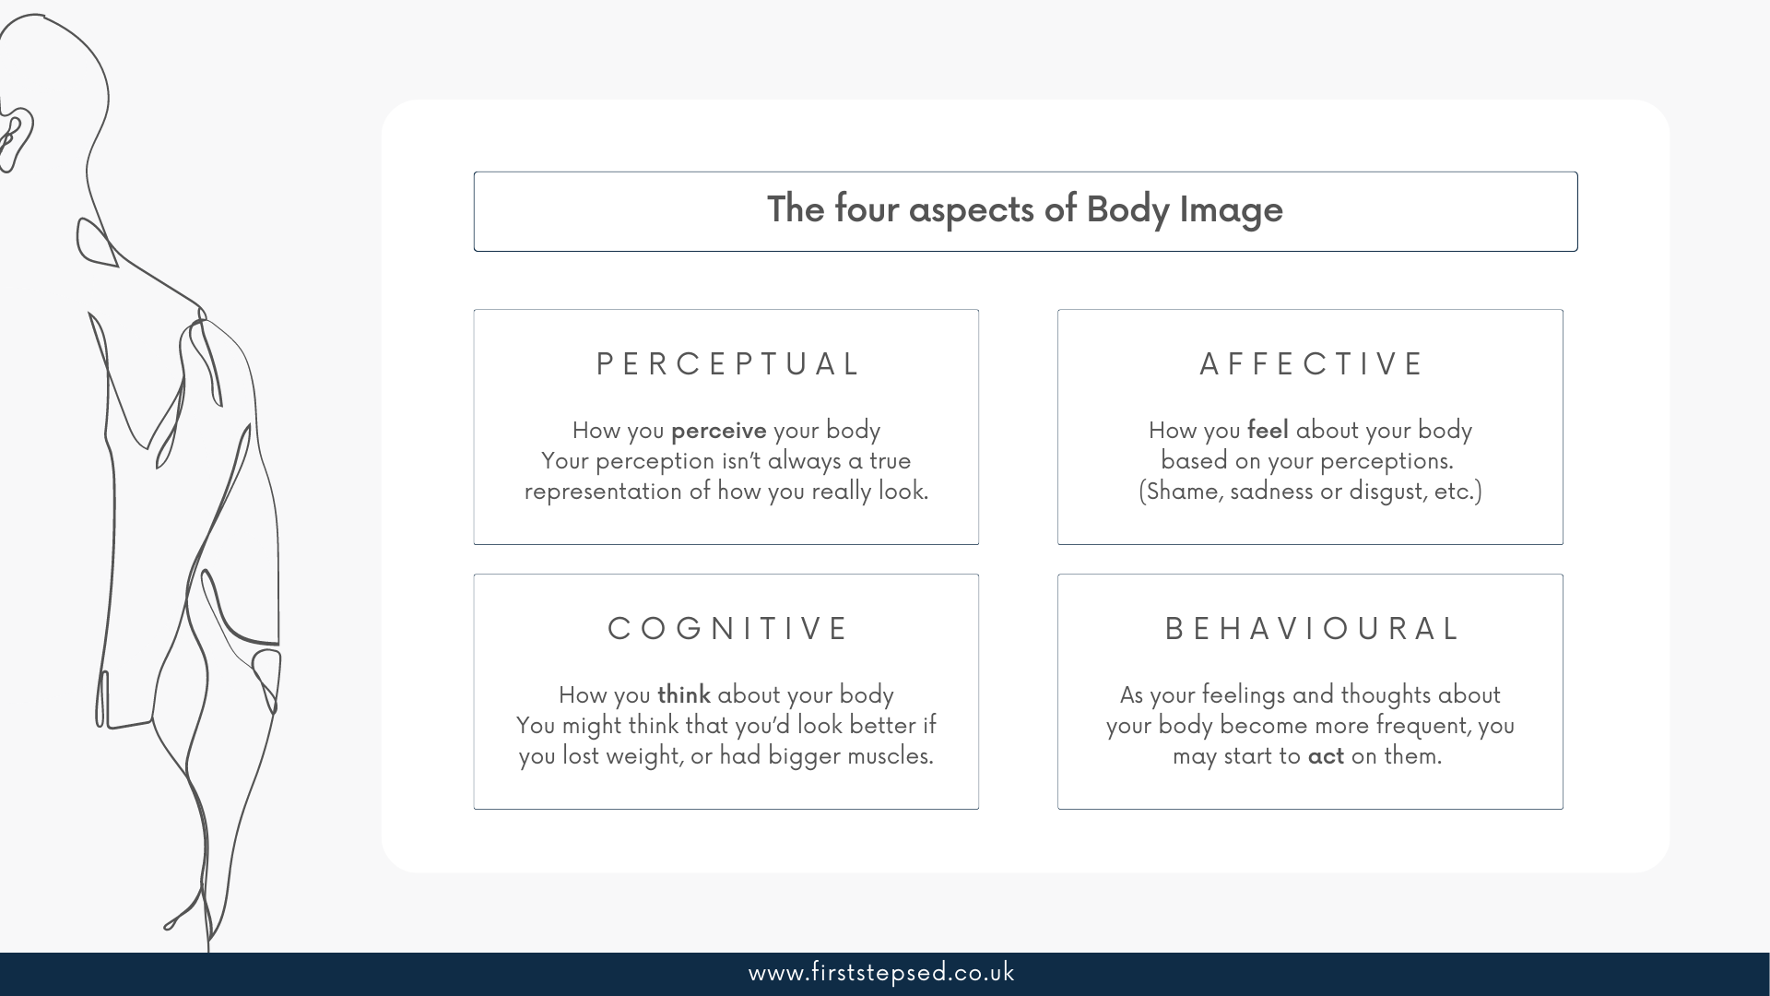
Notes:
Read more at: https://firststepsed.co.uk/resources/body-image-and-perception/
Bullying and discrimination is never far from the conversations around children and eating disorders.
Bullying can lead to low self-esteem, isolation, negative body image, and has also been shown to directly contribute to the development of eating disorders.
Bullying can begin at a very young age, at home, in school and from peers with children in larger bodies often being the target for teasing. For this reason, it is important that schools and parents/carers introduce conversations around weight stigma and be more mindful in their discussions around obesity.
Quote: “I thought fat was the worst thing you could ever be from as young as I can remember. I was so wrong. Being a bully is worse than being fat. Having that kind of prejudice and hatred against people ‘different’ to you is much worse. My body size has nothing to do with my character, and I deserve respect no matter how I look.”

Slide 16
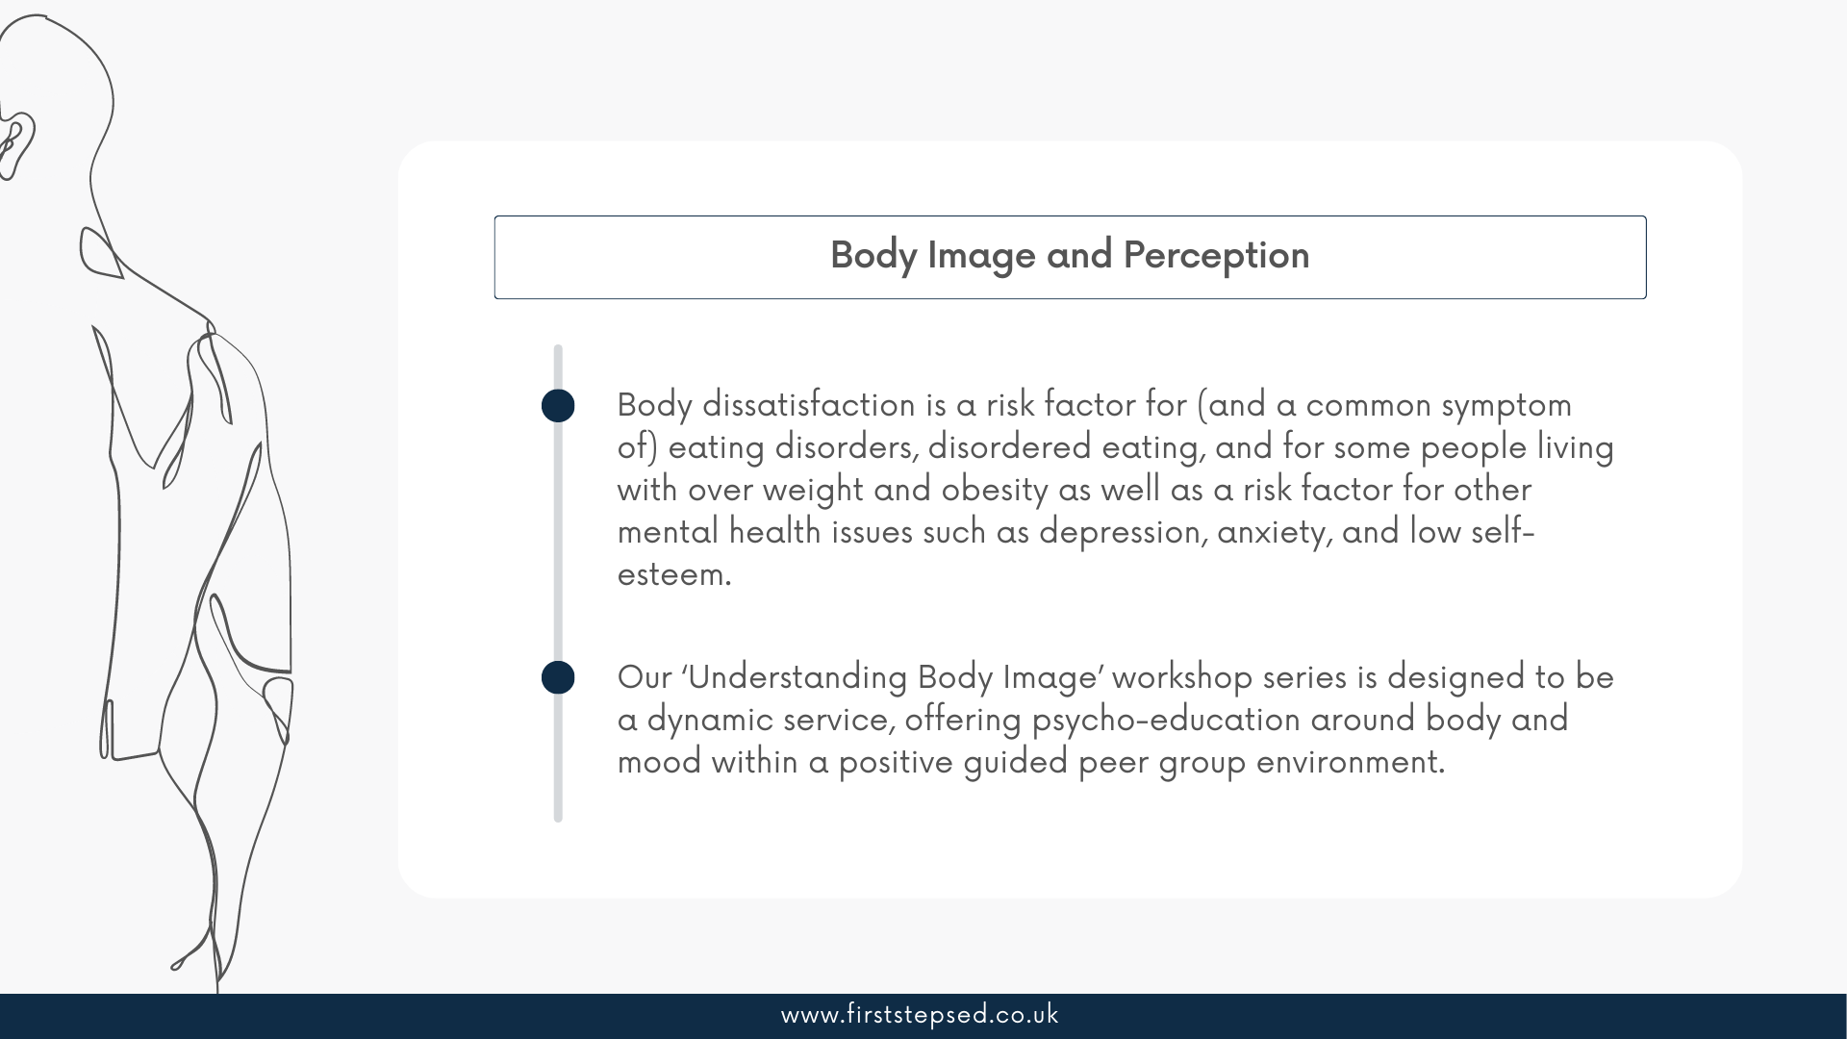
Body Image and Perception
Notes:
Read more at: https://firststepsed.co.uk/resources/body-image-and-perception/
For people at higher weights, body image and disordered eating can often be ignored and weight management strategies may be suggested instead.
This may end up only making any disordered eating much worse. Many people in larger bodies are wary of visiting their GP for this reason – not being believed, being palmed off to lifestyle services, for being judged and stigmatised, treated like a stereotype.
Sometimes this perceived or anticipated weight stigma is just as harmful.
If you’re a person in a larger body, you may feel like your weight is your own fault for not having enough willpower or for being out of control. Society often makes these assumptions about larger bodied people. There might be assumptions made about the way you eat, and people may have offered weight loss advice, even if you didn’t ask for it. One of the very worst things to suggest to people having a difficult time with food is dieting or restriction – it can be one of the very reasons they’re struggling in the first place.
Stereotypes and myths about eating disorders are harmful for most people struggling who aren’t thin – which is the majority…
Less than 6% of people with eating disorders are underweight – ANAD

Slide 17
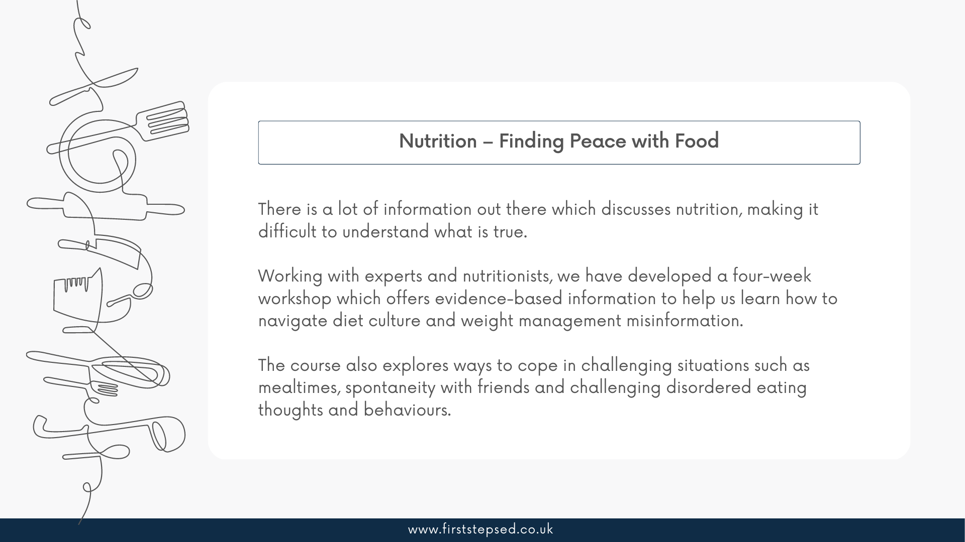
Notes:
There are a number of things that can affect a child’s relationship with food, including the way their parents and peers approach nutrition and body image.
Exposure to negative attitudes around food can be really damaging to a child’s own beliefs about food and can lead them to believe some foods are ‘good’ or ‘bad’.
Diet culture plays a role in a young person’s development. From a young age we are exposed to dangerous societal expectations which recommend unsafe practices around food and a culture which idolises dieting and ‘thinness’ and ‘muscularity’ and clean eating. The education being focused on counting calories rather than on the Carbohydrates, Proteins, Fats, Vitamins, Minerals, Fibre, and Water the 7 major groups of nutrients each performing different and unique functions in our body, and essential because they work together to contribute to our health.
Frequent exposure to messages which labels our foods, puts unhealthy diets and behaviours on a pedestal and connects our self-worth to our weight is extremely dangerous. Children are learning that there is one way to eat, and to be worthy we must look a certain way. This ideology stigmatises people who don’t conform to these expectations.

Slide 18
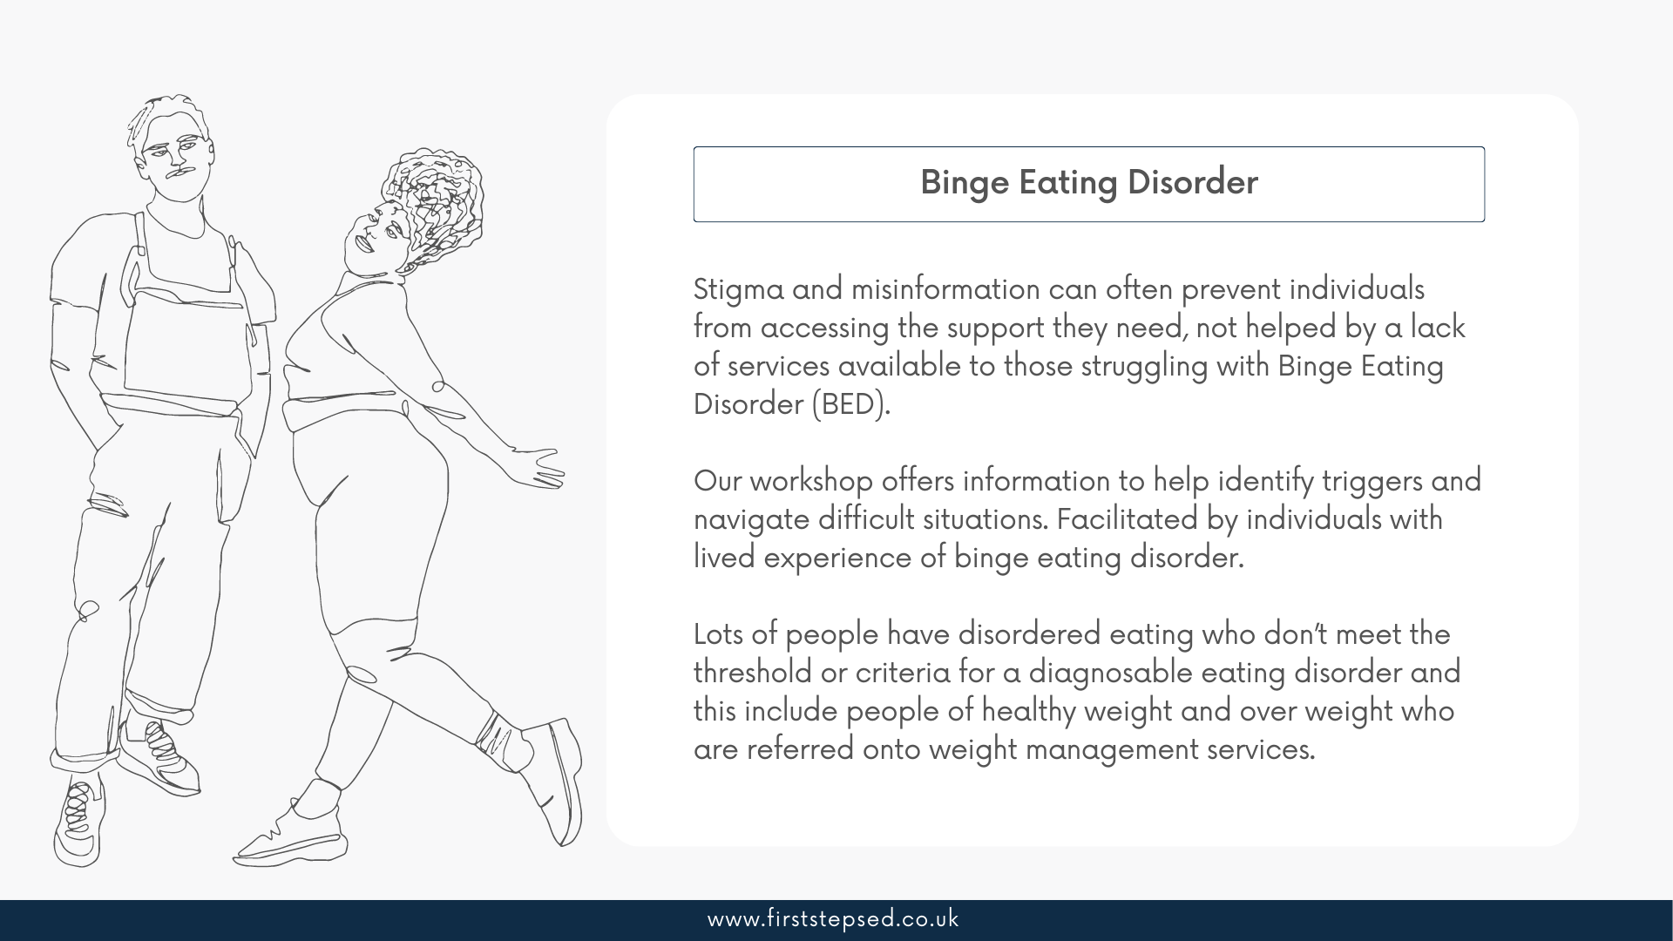
Binge Eating Disorder
Notes:
This may end up only making any disordered eating much worse. Many people in larger bodies are wary of visiting their GP for this reason – not being believed, being palmed off to a weight management service, for being judged and stigmatised, treated like a stereotype. Sometimes this perceived or anticipated weight stigma is just as harmful.
There might be assumptions made about the way you eat, and people may have offered weight loss advice, even if you didn’t ask for it. One of the very worst things to suggest to people having a difficult time with food is dieting or restriction – it can be one of the very reasons they’re struggling in the first place.

Slide 19
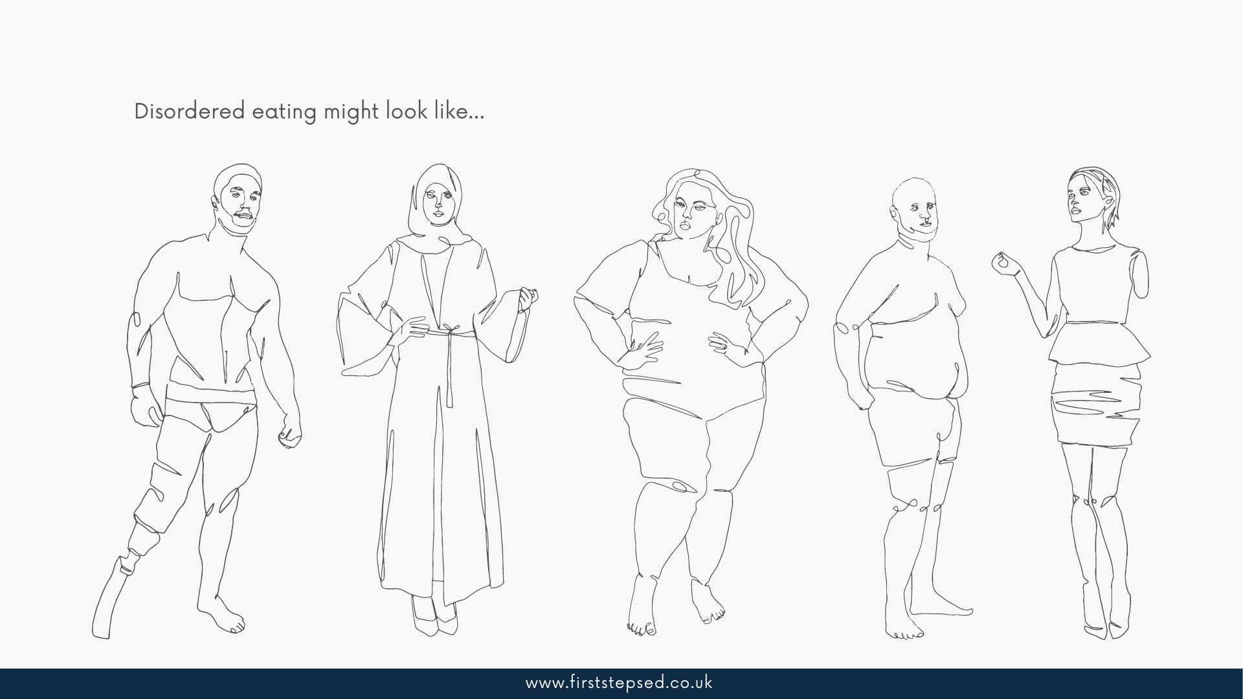
Binge Eating Disorder
Notes:
Thin people can have binge eating disorder, and fat people can have anorexia, and anyone of any weight, gender or ethnicity can have any kind of eating problem. Eating disorders are about thoughts and behaviours, so shouldn’t be judged on body size.
Anyone of any body size can struggle with disordered eating and/or negative body image. However, the discrimination people in larger bodies have to deal with can cause even more problems. This is called weight stigma and refers to the ways that people in larger bodies are treated, which may not be obvious as it is something that is very normalised and is “systemic” – meaning the issues run from the top through systems, policies and practices. So weight stigma is more likely to show up in ways that are subtly woven through everyday life.
Last year, Ireland was the first European country to change the narrative on body image and obesity having followed Australia and Canada who first led the way to show the better way for their society an inclusive and equitable policy to tackle and support people living with obesity.

Slide 20
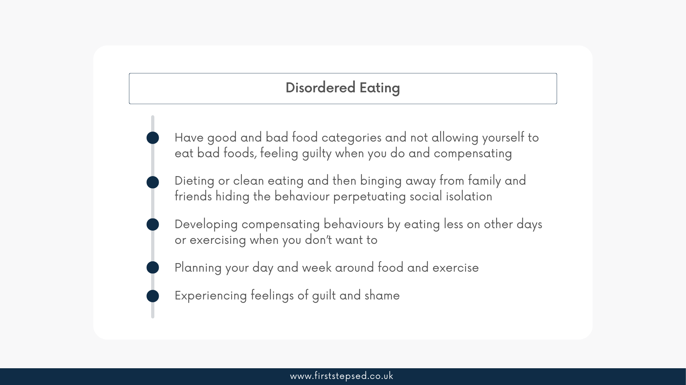
Disordered Eating
Notes:
Disordered eating has become mainstream and even encouraged in society that many of us don’t realise our thoughts and feelings around our body image, our relationship with food are not healthy and those who are vulnerable without support can quickly spiral into dangerous eating disorders.
Quote: ‘’Feeling guilty over everything I eat, recording what I do eat, the number of calories of each meal and trying to keep to my calorie goal each day ignoring my hunger. I know this isn’t healthy but I am morbidly obese and diabetic’’.
Quote: ‘’Something I’ve realised I do is to overeat then accidentally making myself sick because I know that if I take leftovers home someone else will eat them before I have chance to, so I have to eat it all now or I wont get it’’.
‘’I also had that growing up and with an ex partner. It really exacerbated binge eating for me and I struggle with it to this day’’.

Slide 21
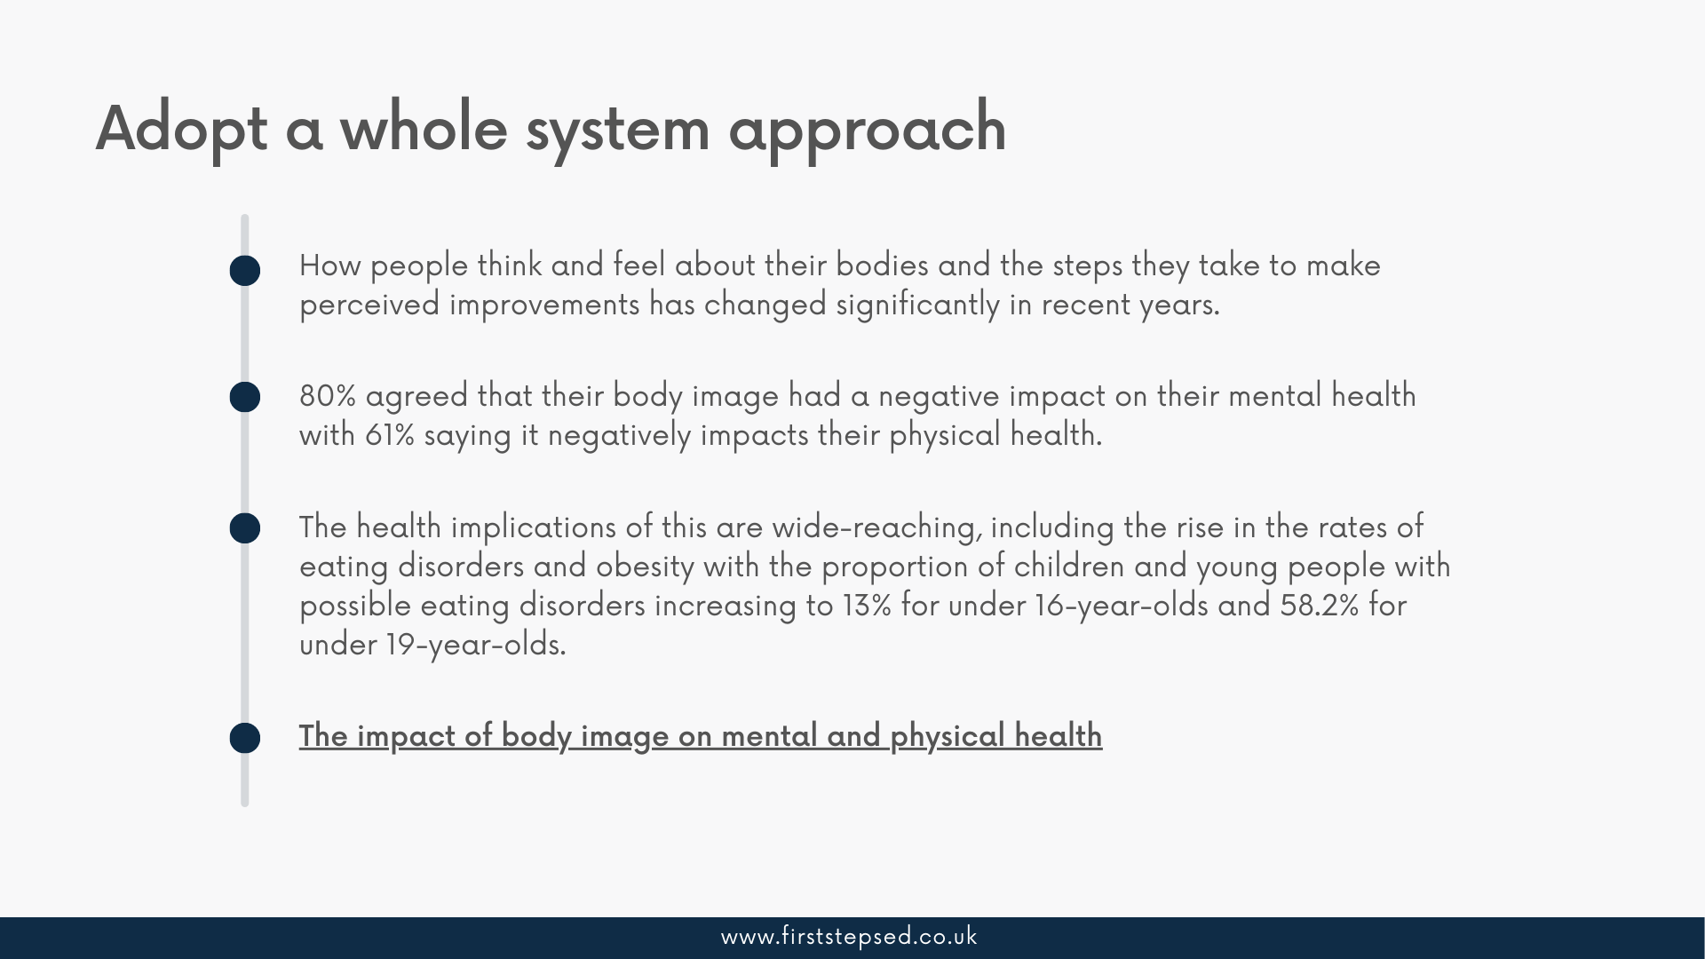
Notes:
We need to appreciate and incorporate multiple perspectives:
Improve nutrition education and literacy in our children and young people and parents and care givers:
Causal factors in one domain (obesity) thwart progress in other domains (eating disorders) so a whole system approach is needed:
At First Steps ED we work with partners focused on the Human Learning Systems commissioning and managing in complexity approach.

Slide 22
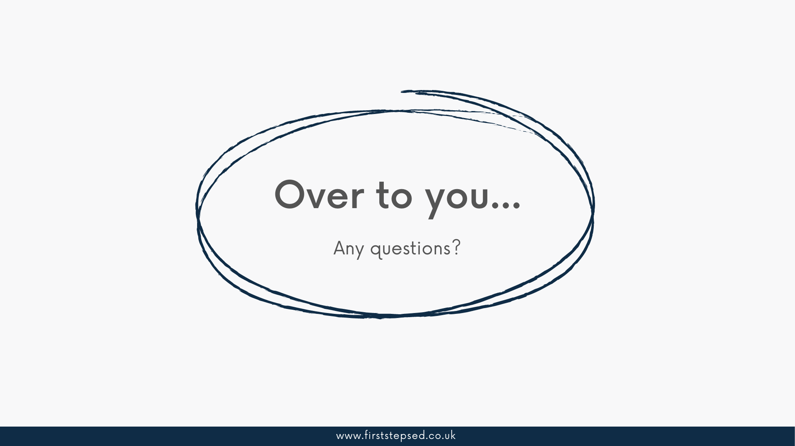
Q&A Session

Slide 23
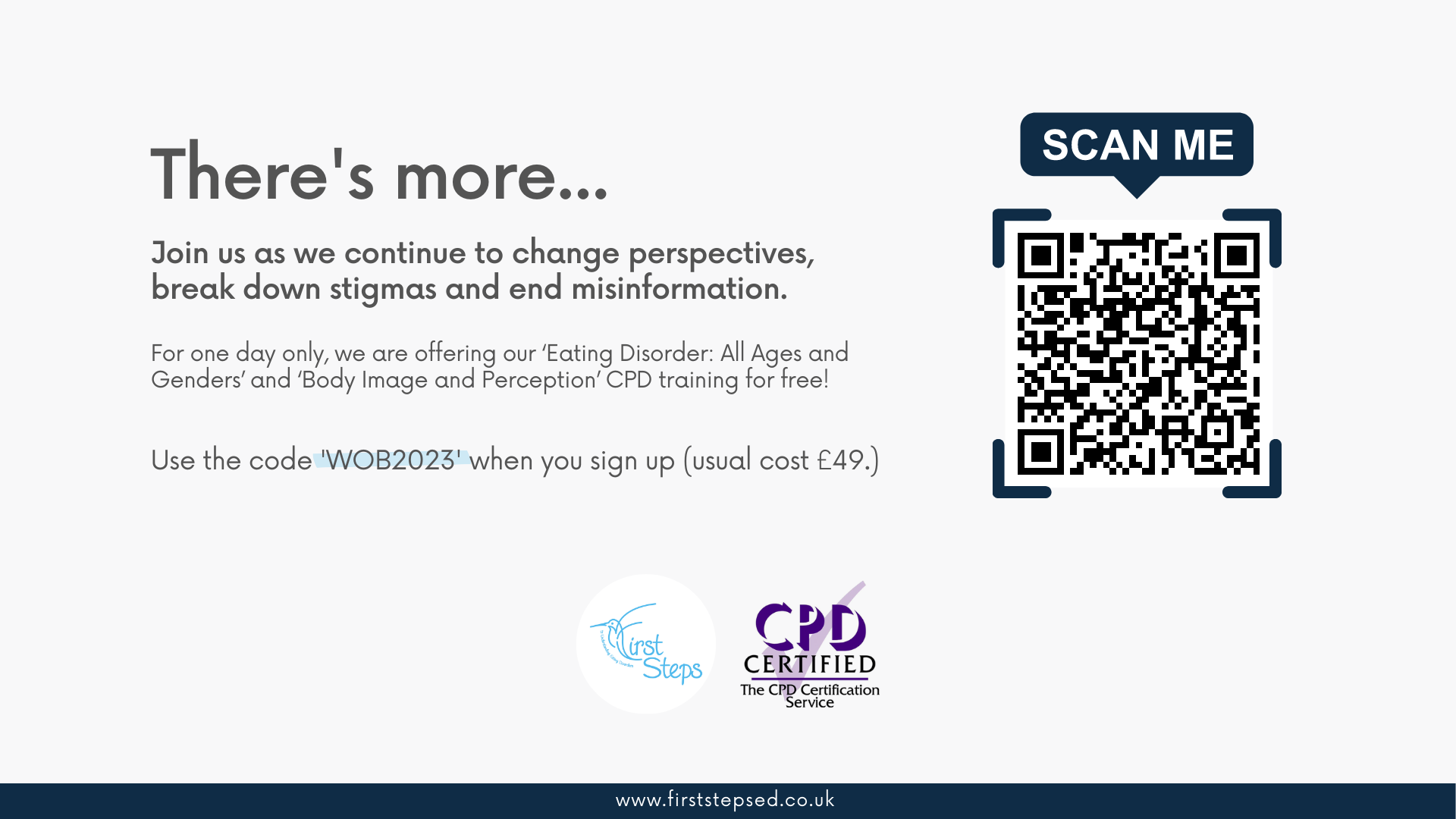

Slide 24
